Slide 1
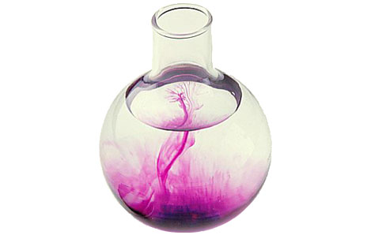
Dissolving and Diffusion
7F Reactions with oxygen – What is burning?
Unit 1
Lesson 2

Slide 2

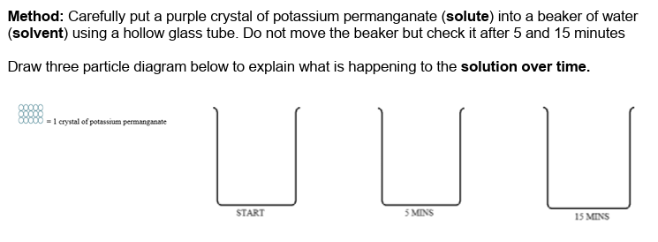
Starter: set up practical (page 9)

Slide 3
Today’s Aim
7F Reactions with oxygen – What is burning?
Topic 1
Lesson 2
By the end of this lesson I will be able to explain how the processes of dissolving and diffusion can be used as evidence for the particle model

Slide 4
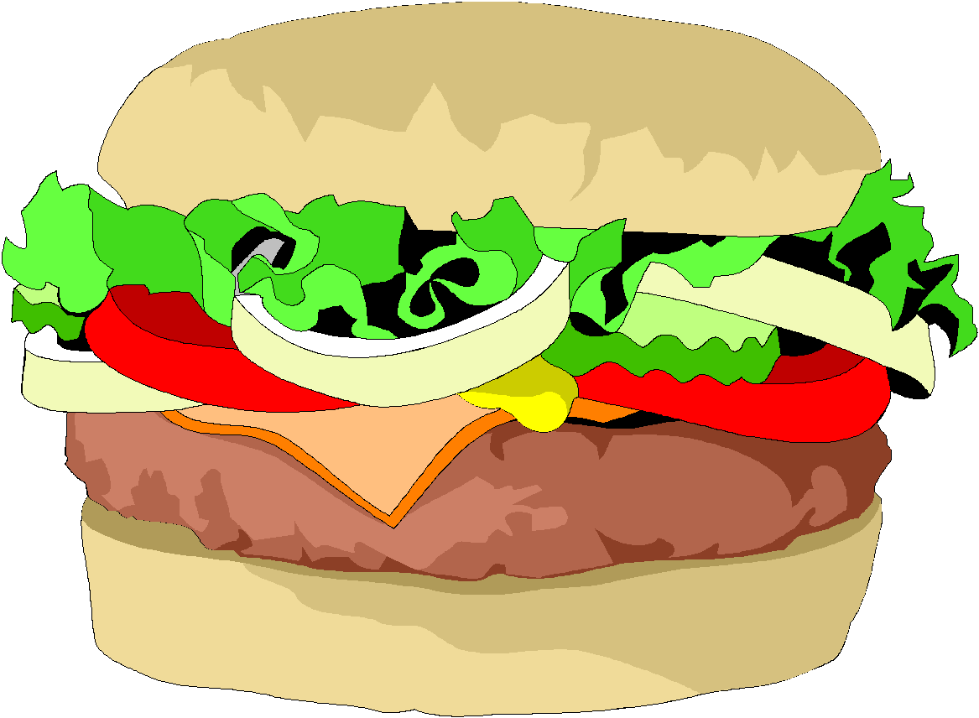
Diffusion
Diffusion is the random movement and mixing of particles in a liquid or gas. For example, consider the scent from a burger…
The “scent particles” from this hamburger are in high concentration here
Eventually they will diffuse around the entire room

Slide 5

Hands up when you can smell it

Slide 6
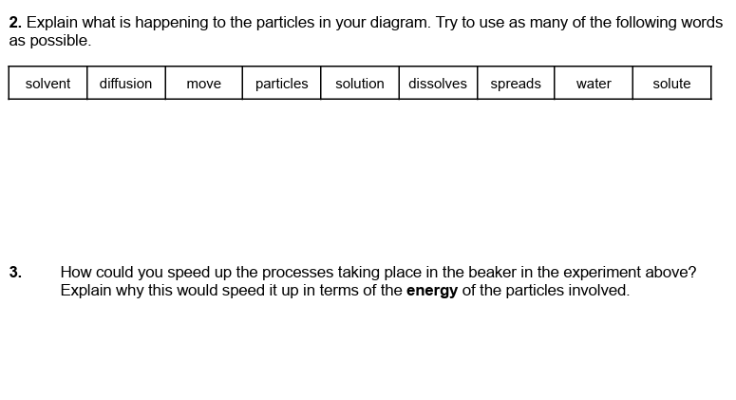
Dissolving and Diffusion (page 9)
When the crystal (the solute) is put into water (the solvent), it dissolves. The water particles are constantly moving around and some will bump into the dye particles and move them about. This random movement is called diffusion. We see the colour spread throughout the water making a purple solution.
At a higher temperature, the particles have more energy which means the particles move about faster.
The water particles and dye particles therefore mix quicker and so we see the purple colour spread out faster.

Slide 7
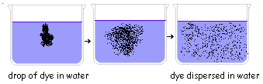
Diffusion in liquids

Slide 8
Diffusion is the spreading out of particles

Slide 9
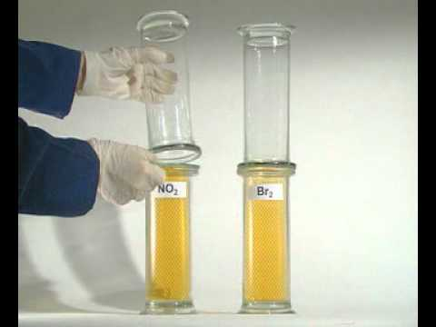
Watch this video about diffusion
Notes:
https://www.youtube.com/watch?v=_oLPBnhOCjM
Total length 04min 01sec.

Slide 10
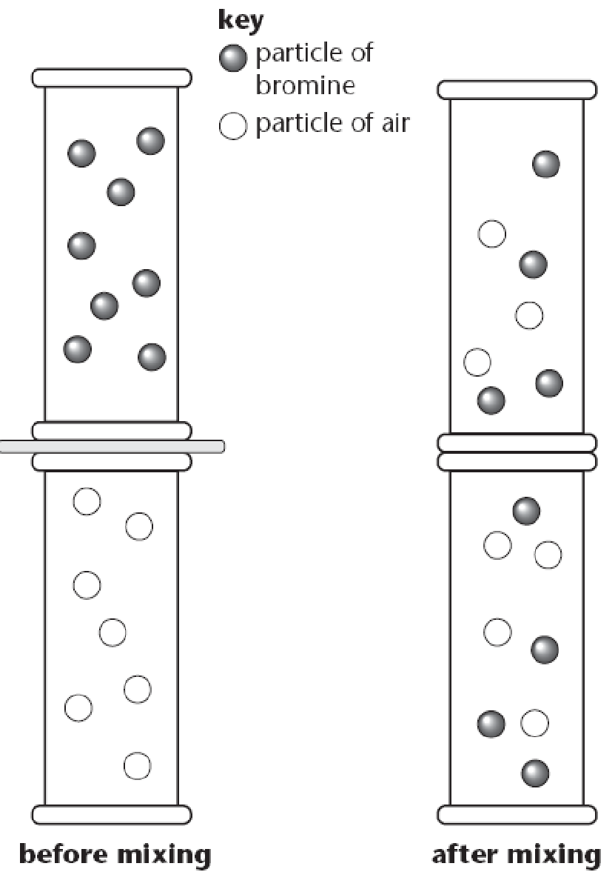
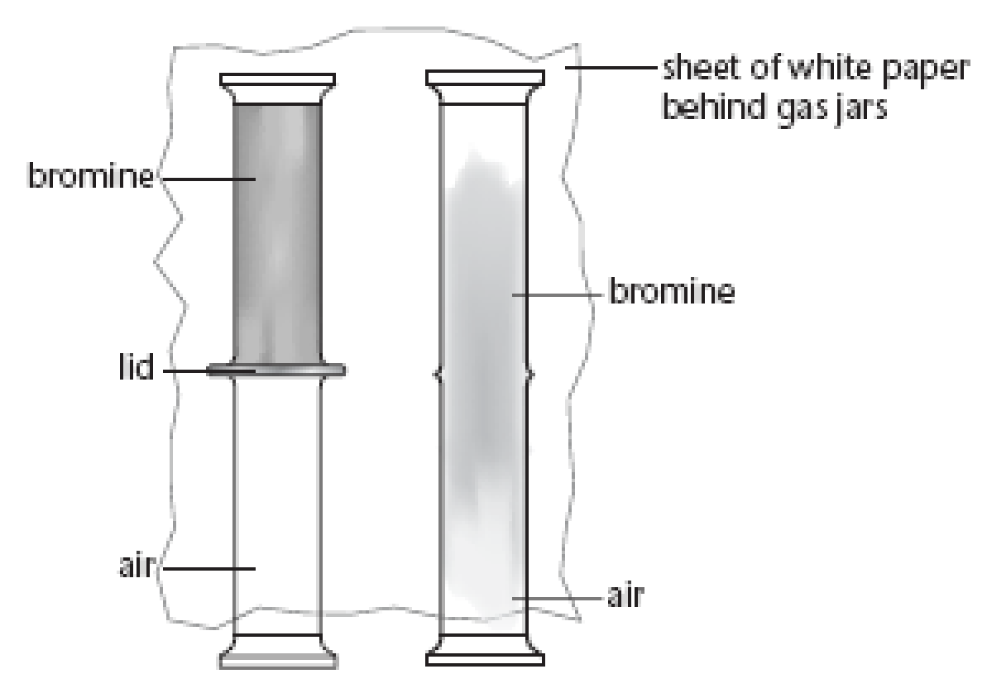
Diffusion in Gases
bromine
mixture of bromine and air
lid
air

Slide 11
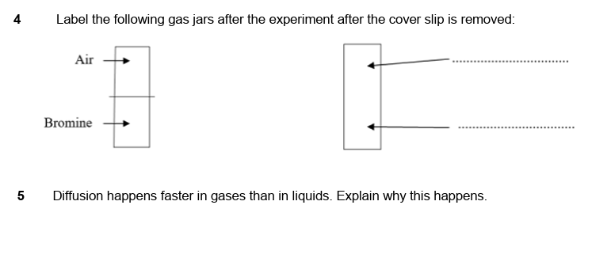
√ Dissolving and Diffusion (page 9)
Uniform mixture of air and bromine throughout the gas jars
The particles in a gas have more energy than in a liquid and therefore move about faster.

Slide 12
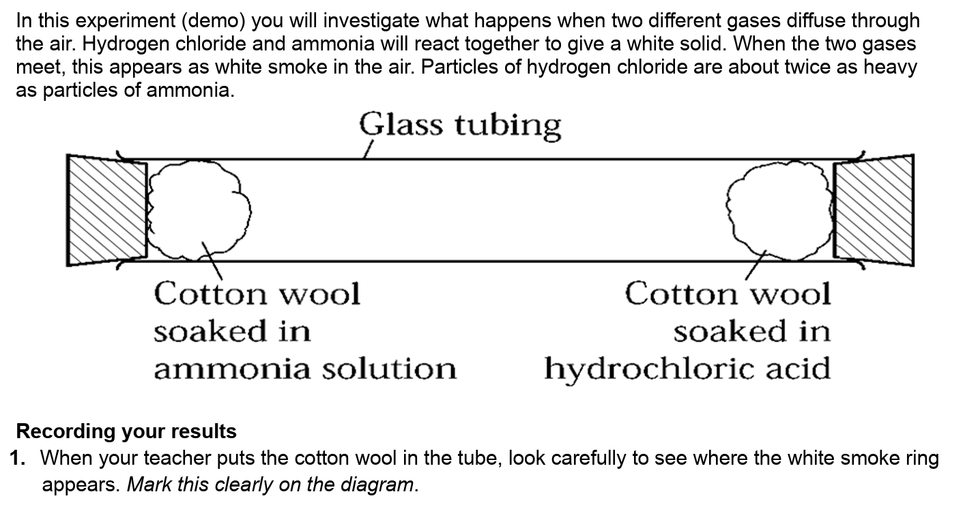
Diffusion Demonstration (page 10)
Prediction

Slide 13
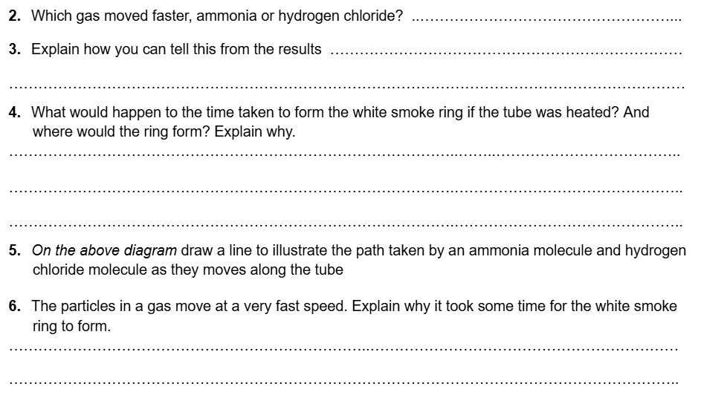
Considering your results (page 10)
Prediction
ammonia (about twice as fast)
the white smoke formed closer to
the hydrogen chloride side so it travelled further in the same amount of time
The ring would form faster but still in the same place.
Heating up the particles does not change their mass, so although the particles will move faster, both the heavy and light particles will increase in speed by the same amount..
The particles are constantly bumping into the air particles in the tube. Although they are moving very fast, they are constantly changing direction as they move around the tube.

Slide 14
Plenary: check out your results (page 9)

Slide 15
What you need to know
Topic 1
Lesson 2
Syllabus Content
1.3 understand how the results of experiments involving the dilution of coloured solutions and diffusion of gases can be explained.
My Learning

